Slide 1
Visual ICL

Slide 2
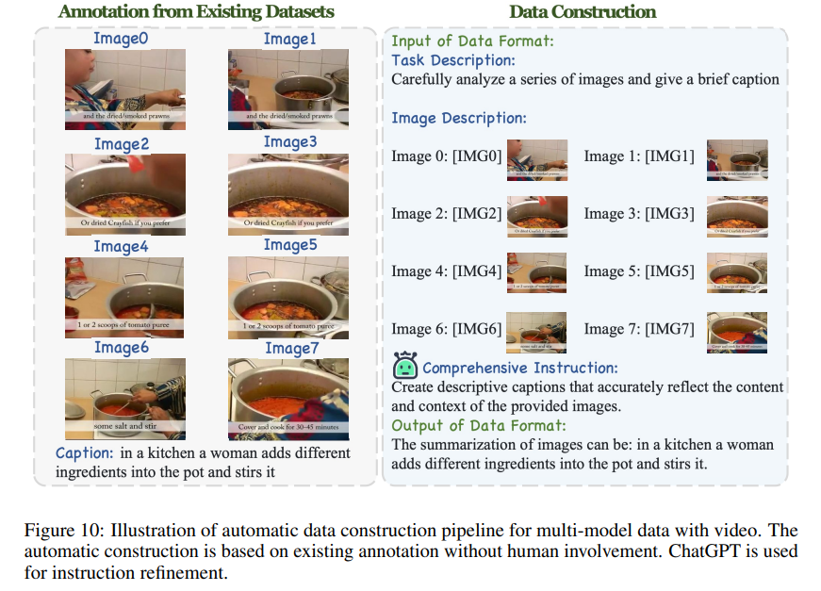
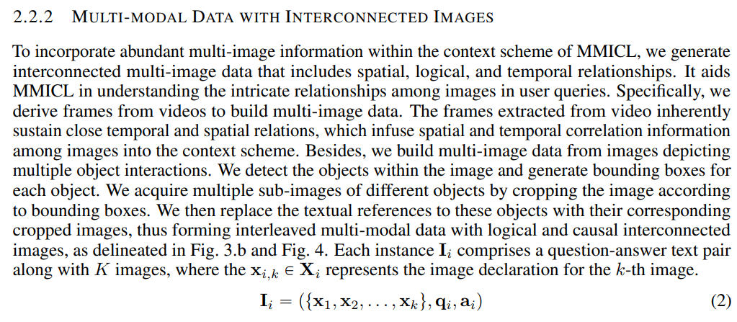
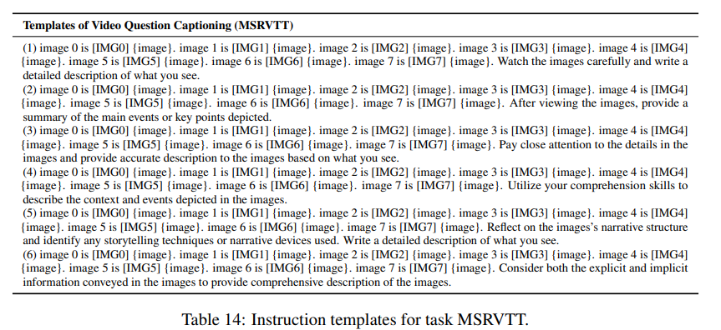
Similar works For In-Context Learning
MMICL: EMPOWERING VISION-LANGUAGE MODEL WITH MULTI-MODAL IN-CONTEXT LEARNING (ICLR 2024)

Slide 3
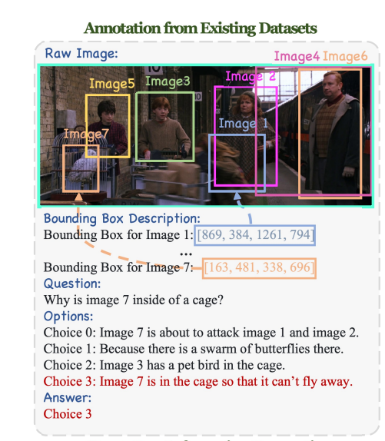
1 prompt change – 1/2

Slide 4
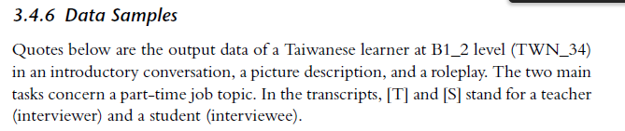
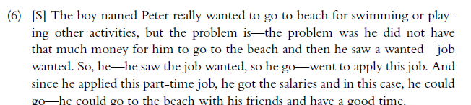
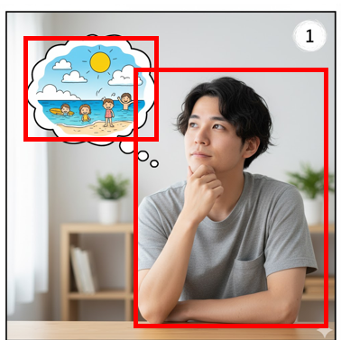
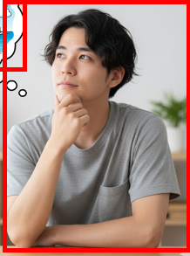

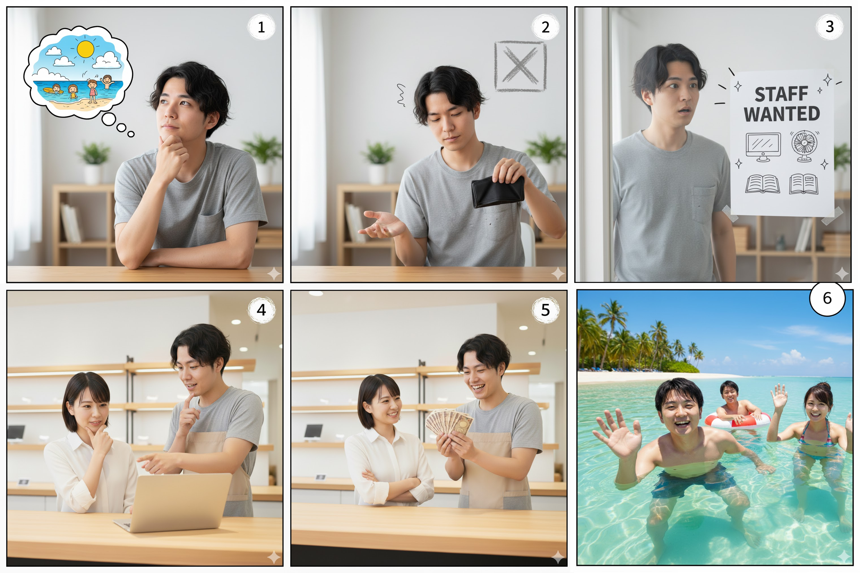
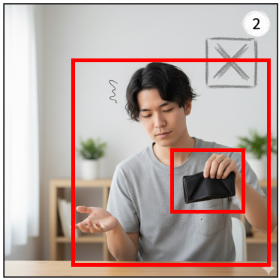
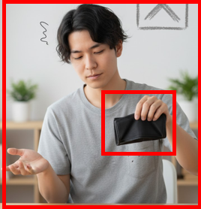

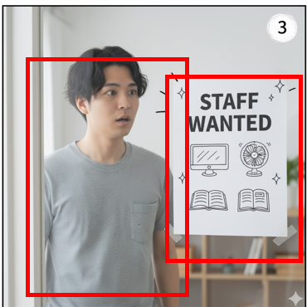
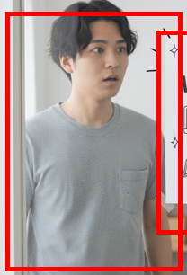

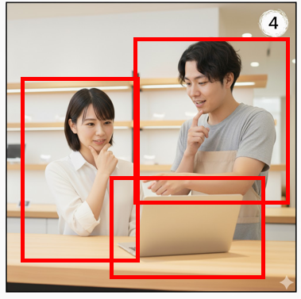

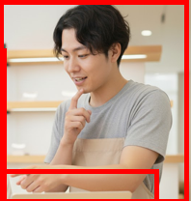

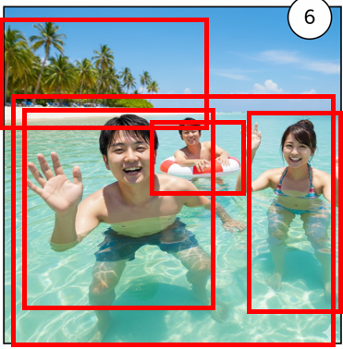



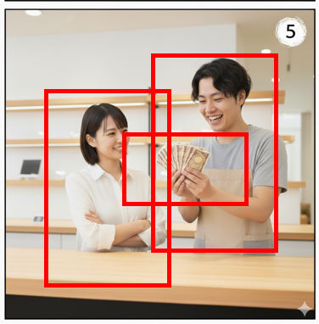


1st prompt change– 2/2
Taiwan Student:
Q[S]: The boy named Peter really wanted to go to beach for swimming or playing other activities
Q[GT]: <Interviewed/GPT-generated>
Q[S]: but the problem is—the problem was he did not have that much money for him to go to the beach
Q[GT]: <Interviewed/GPT-generated>
Q[S]: So, he—he saw the job wanted, so he go—went to apply this job. And since he applied this part-time job
Q[GT]: <Interviewed/GPT-generated>
Q[S]: “”,
Q[GT]: <Interviewed/GPT-generated>
Q[S]: he got the salaries and in this case
Q[GT]: <Interviewed/GPT-generated>

Slide 5
2nd prompt change
Answer

Slide 6
Random Sample
Testing 1-shot, 2-shot to 8-shot
8-shot was the tested performance for 7B-12B Model
(Microsoft Research 2024)- From Introspection to Best Practices: Principled Analysis of Demonstrations in Multimodal In-Context Learning
Random Select – 8 non-native learners to do my 8-shots for each batch
CLIP Select - Compute 8-prototypes captions in the CLIP embedding SPACE - CLIP/BLIP embeddings from trainset (Future Work)
Query test => CLIP-embeddings => Retrieve the nearest 8-CLIP embeddings and use them as 8-Shots for ICL
Considering as Future work

Slide 7
You are an English language learner describing pictures in simple sentences.
Your goal: Describe each picture naturally, as a B1-level student might do.
---

Slide 8
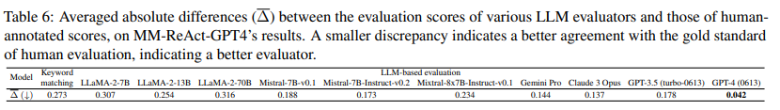
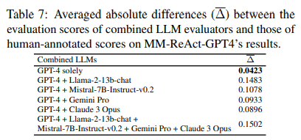
How to evaluate our model
LLM-as-a-Judge
Our Choice: GPT-4
MM-Vet: Evaluating Large Multimodal Models for Integrated Capabilities (NUS – ACL 2023 )

Slide 9
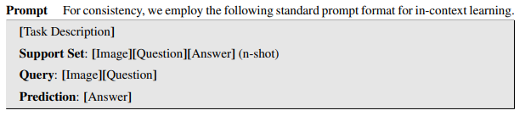
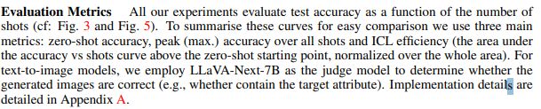
Another Option – Simpler Prompting but misfit Image QA task
VL-ICL BENCH: THE DEVIL IN THE DETAILS OF MULTIMODAL IN-CONTEXT LEARNING

Slide 10
Eval Metrics
For VQA
top 1-k object accuracy
For Text
Fluency, Context Relevance (Qualitative Assesment)
BERTScore / Sentence-BERT cosine: for semantic similarity.
Quantitative: ROUGE and BLEU with references
Arranged audio-recorded Interviews on WK8 (Sat) and WK9 (Mon)
Future Work
Multi-modal Visual-Text Reasoning
Hallucination Benchmark: POPE (Qualitative)
Overall Cognition and Perception Benchmark (Test Against MME – 14 subtasks – Object Accuracy)

Slide 11
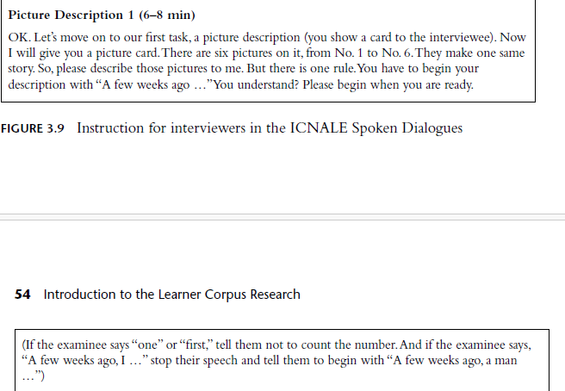
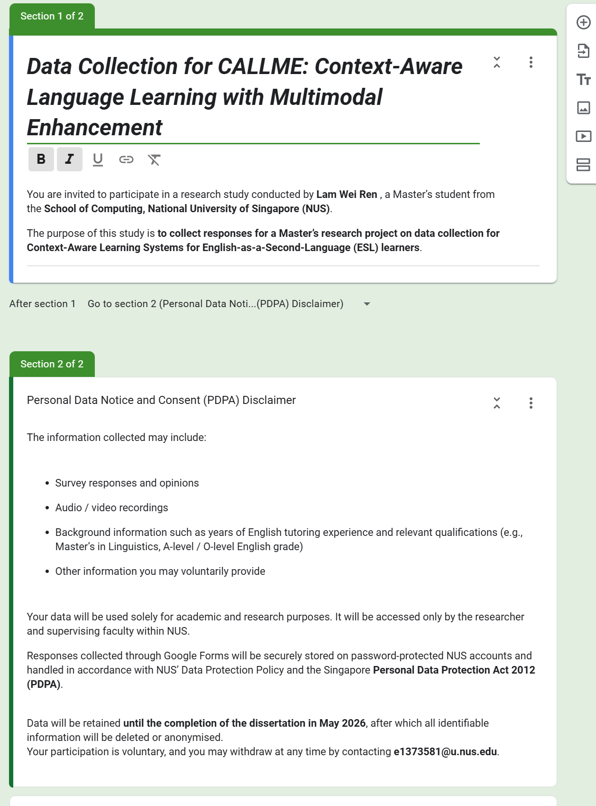
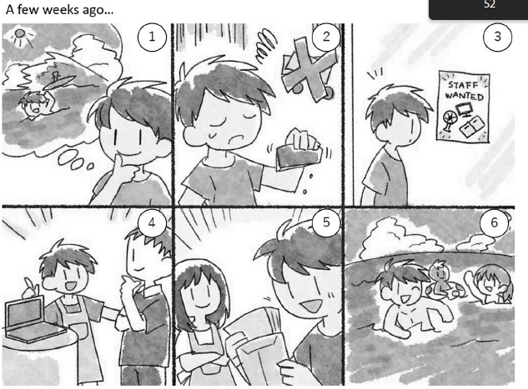
Interview Process
2 participants
1 participant
https://docs.google.com/forms/d/1wtq2taXEEhJgg5WH4kNqpuvCVAqbTHQ1gqvjVikqdnk/edit

